Slide 1
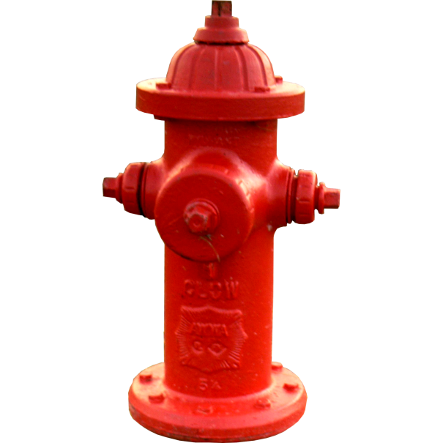
911 Dispatcher
Back to Basics
Team J:
Mingyu Zhang
Peter Hogoboam
Khushali Sandhi
Cheryl Wellum
Mentor:
Tori Rice

Slide 2
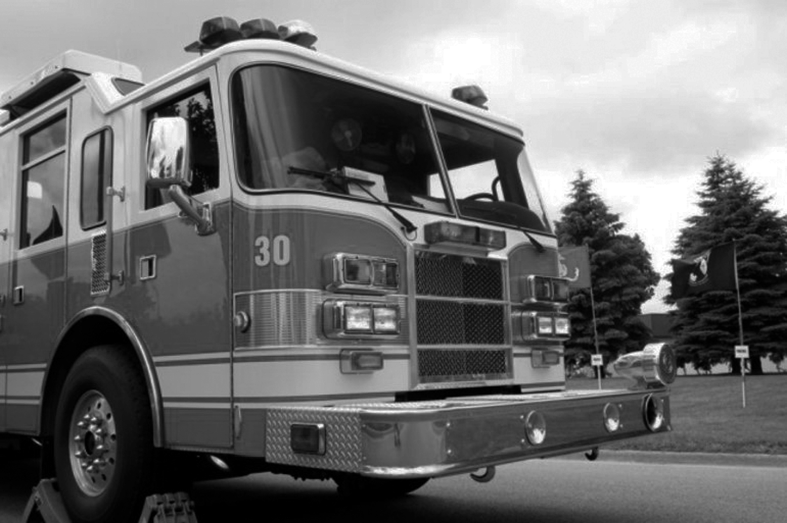
“We either get too much or not enough information.”
“We want the information instantly.”
~Bloomington Firefighter
Image source:http://www.govtech.com/public-safety/Bloomington-Ind-Firefighters-Cite-Problems-with-New-Dispatch-System-.html @ 11.4.2015 used here under educational fair use only.

Slide 3
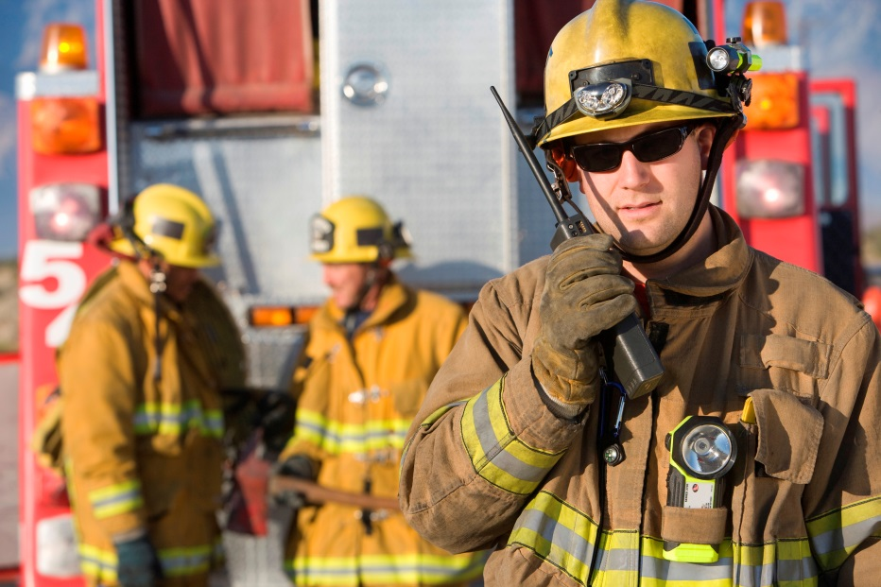
Design Problem
Firefighters either get too much or too little information when needed.
http://activerain.com/blogsview/4486639/mortgage-loans-for-houston-texas-firefighters

Slide 4
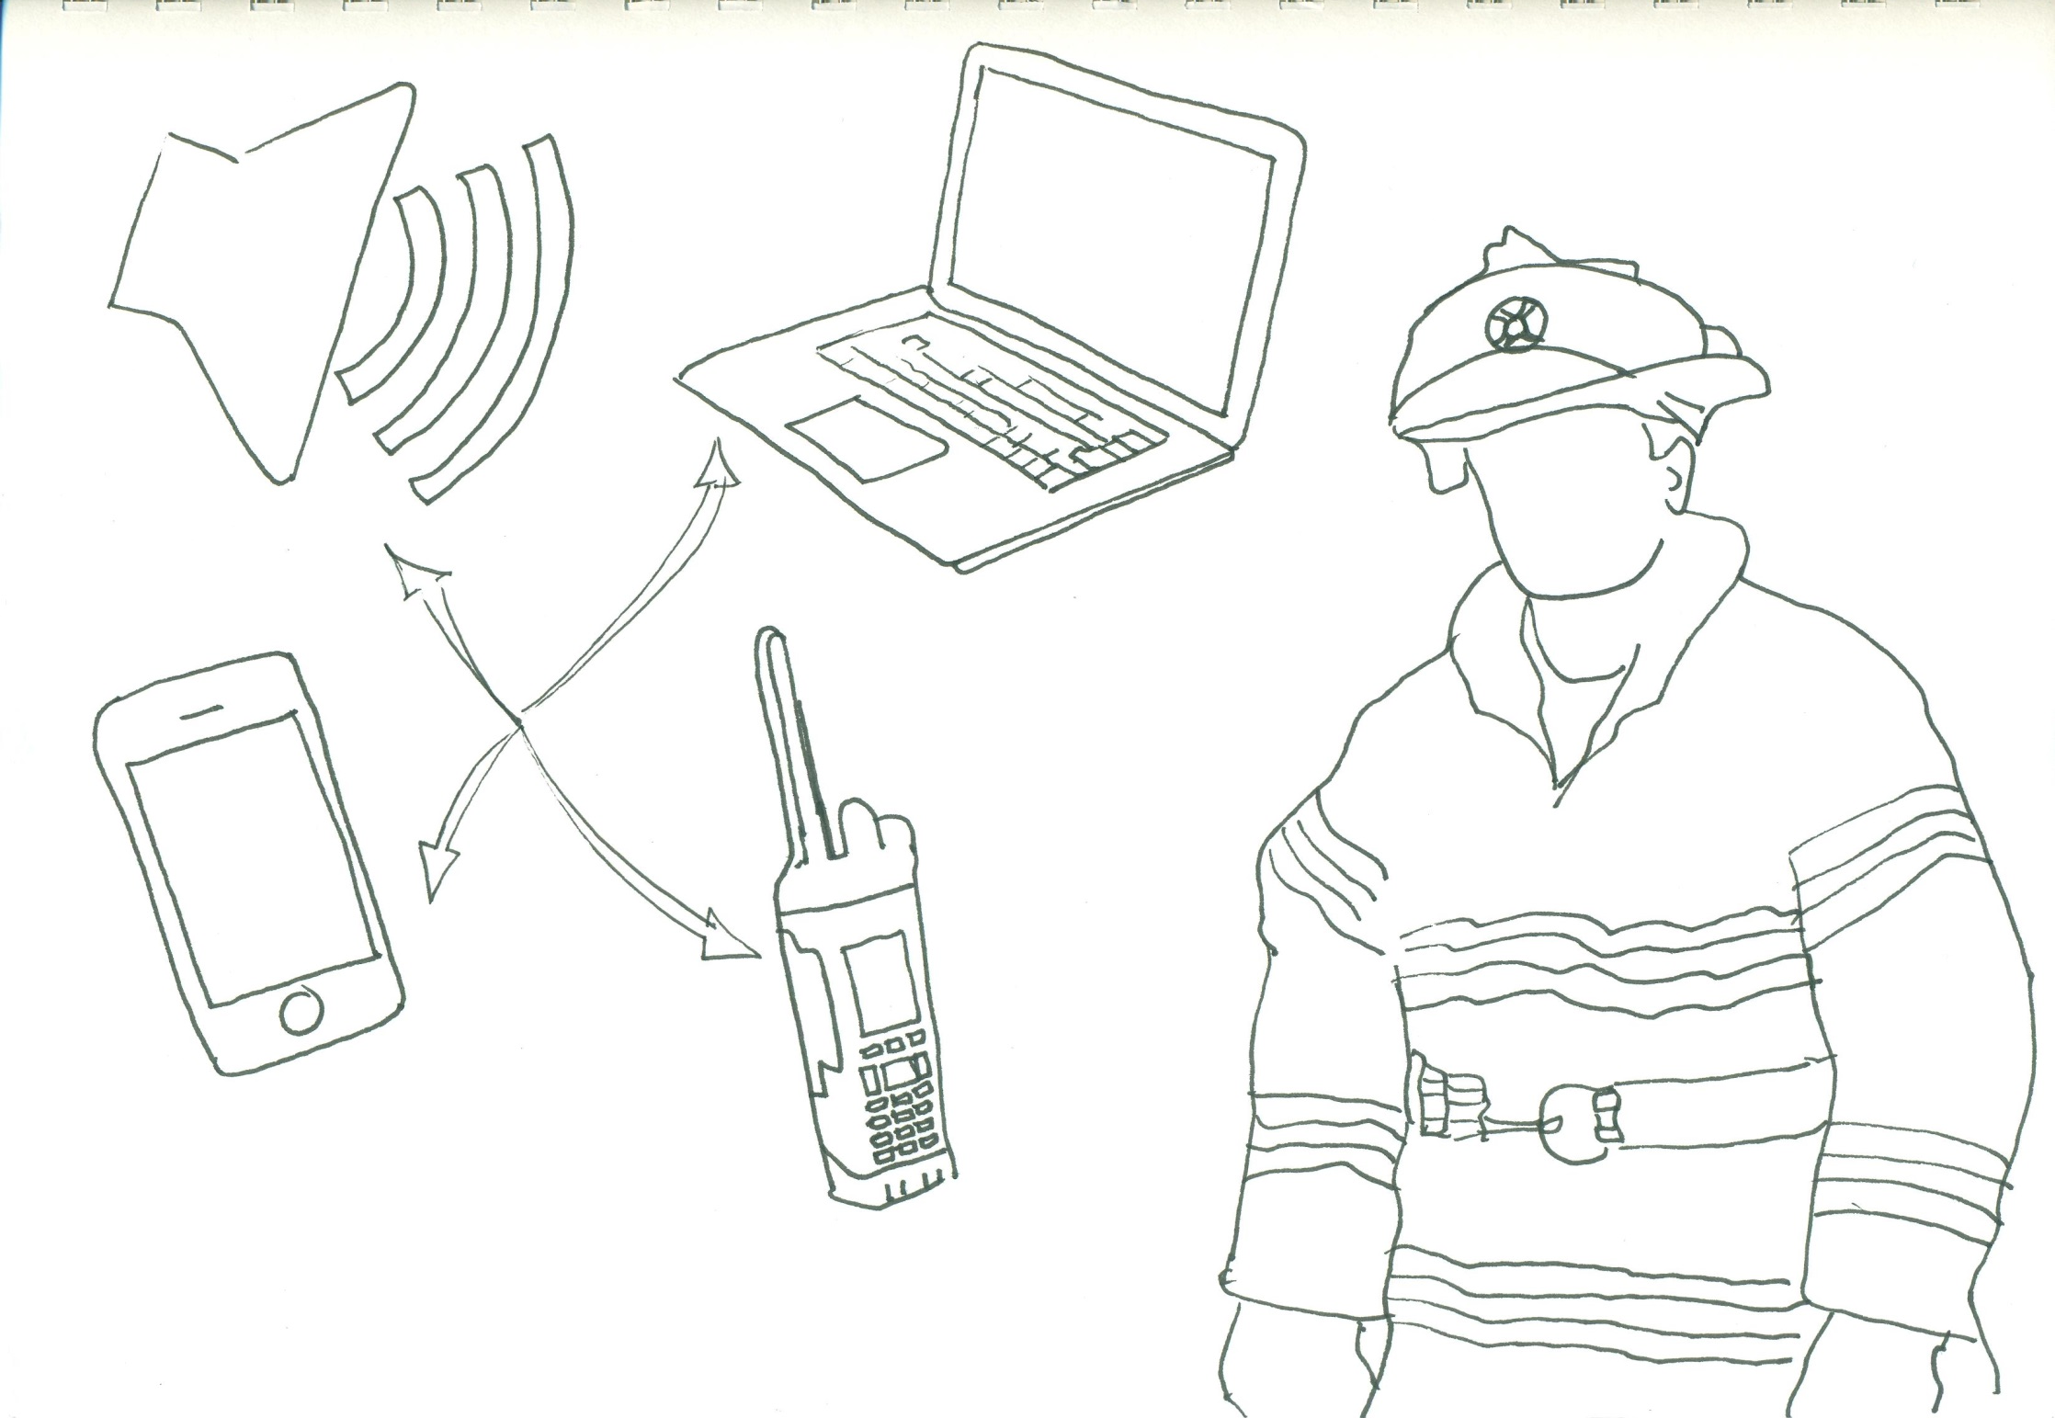
Modes of Communication

Slide 5
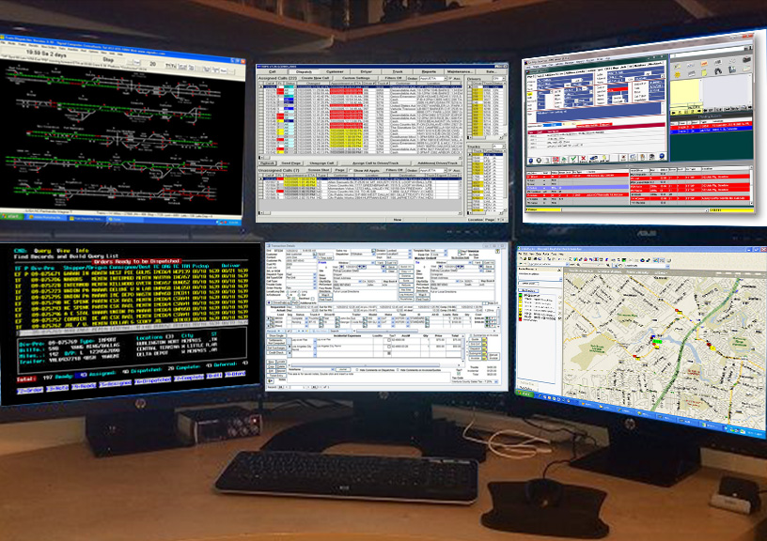

Slide 6
Solution
Creating a step-by-step information collection and communication process by simplifying the dispatcher’s system.

Slide 7
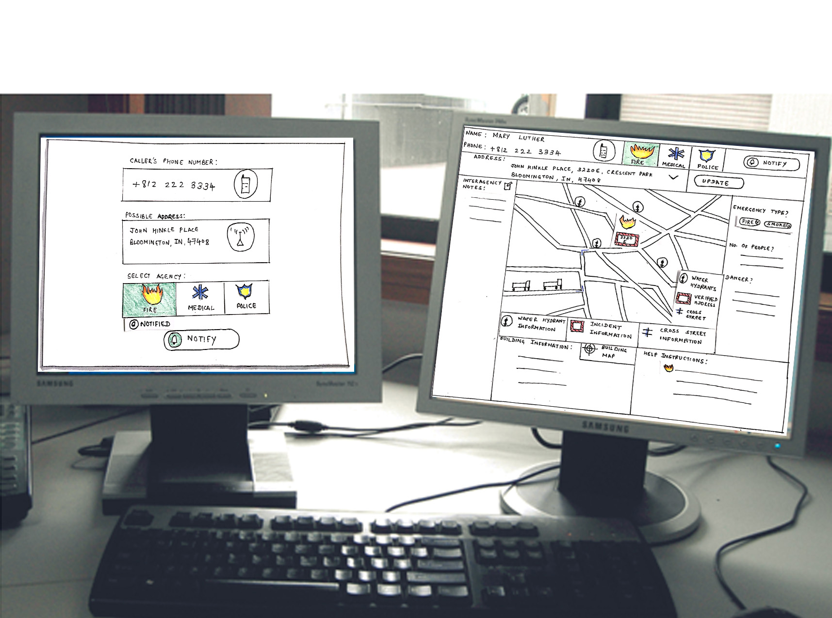
BETTER.

Slide 8

The
New
Hire

Slide 9
GET READY

Slide 10
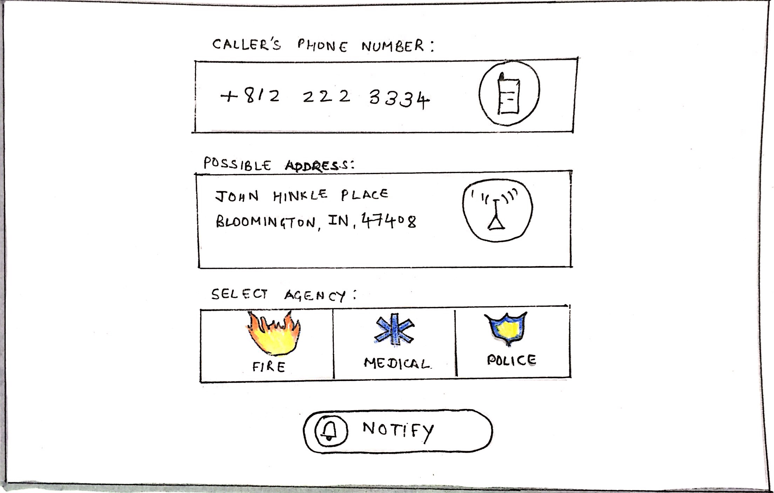


Slide 11
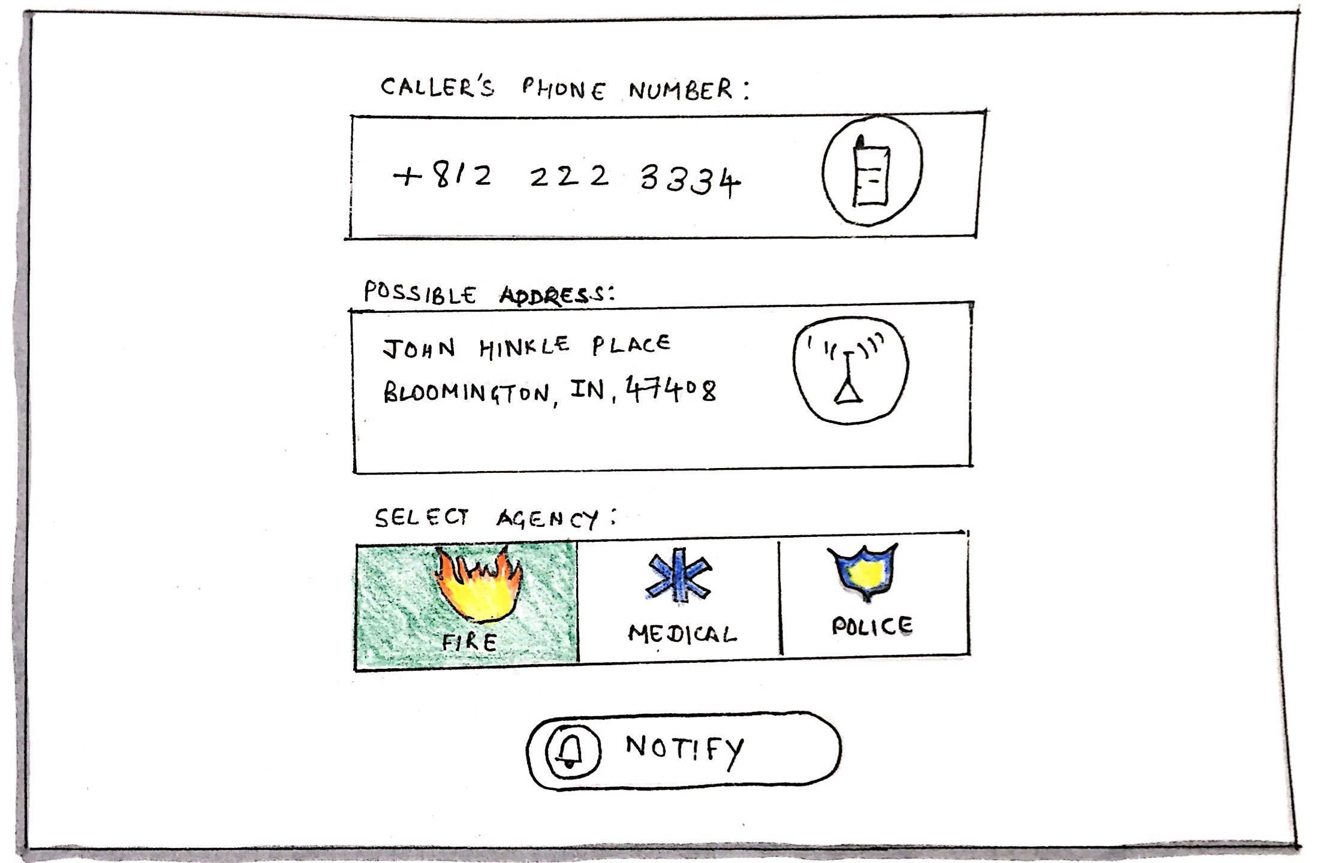

Slide 12
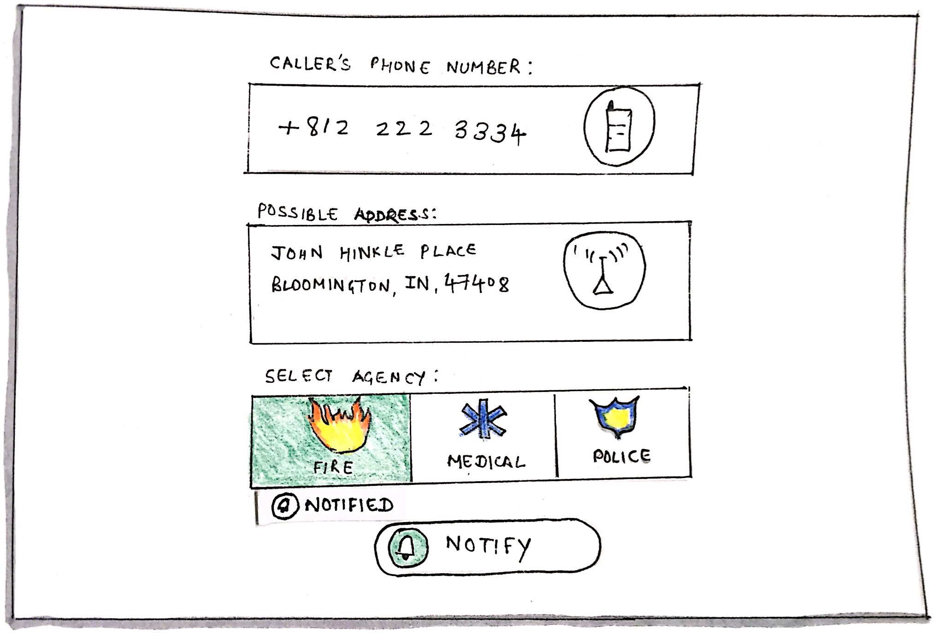

Slide 13
GET THERE

Slide 14
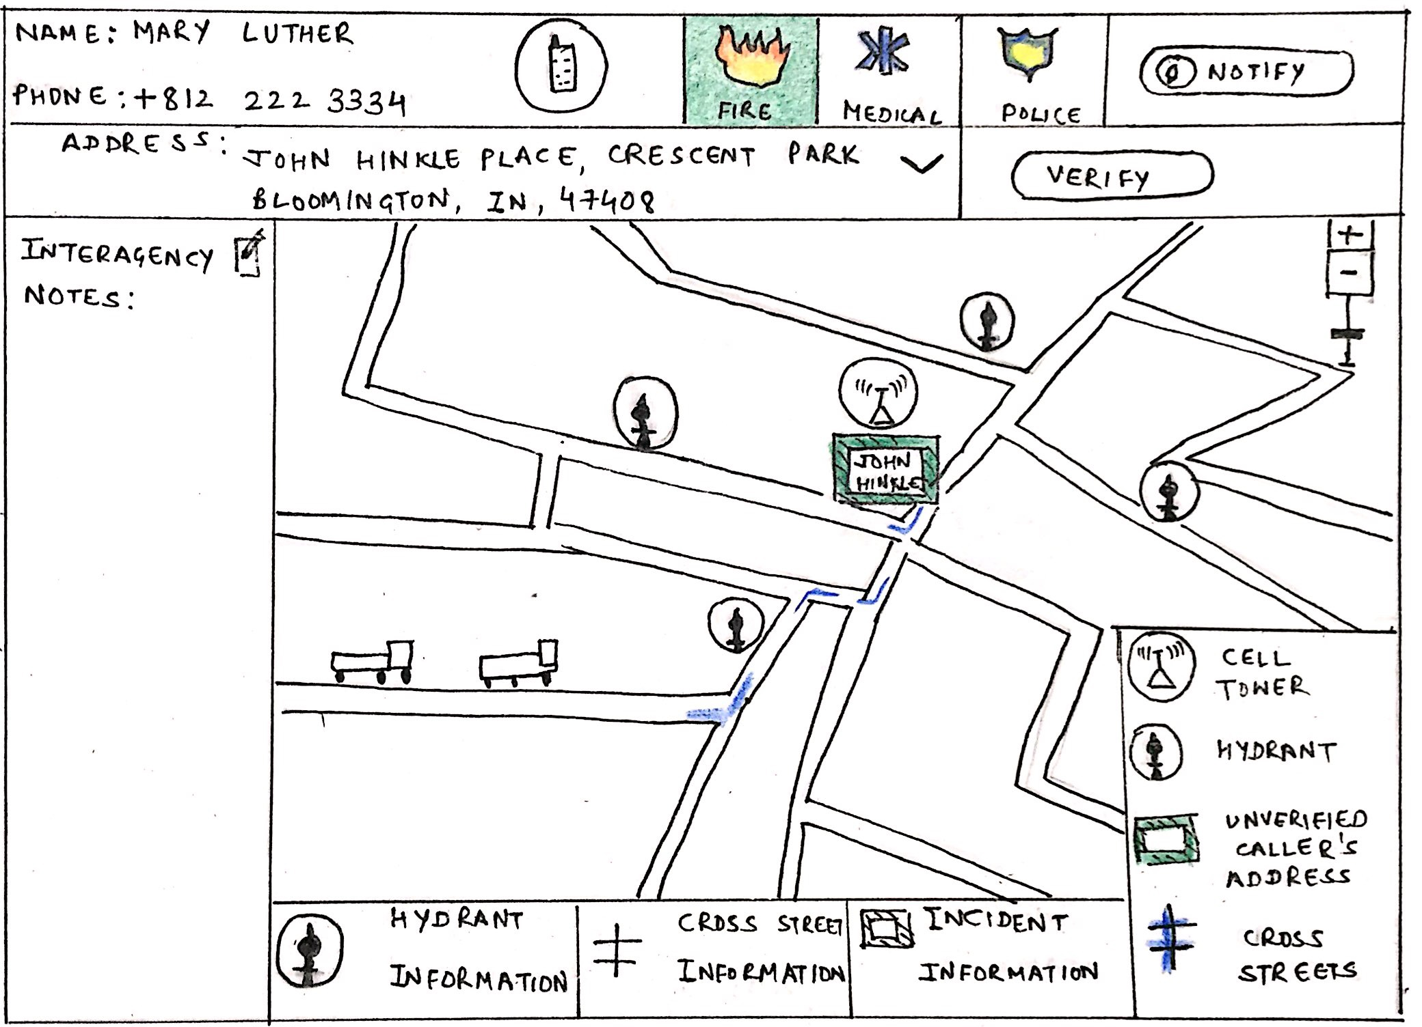

Slide 15
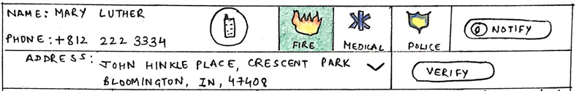

PRIMARY
INFO

Slide 16
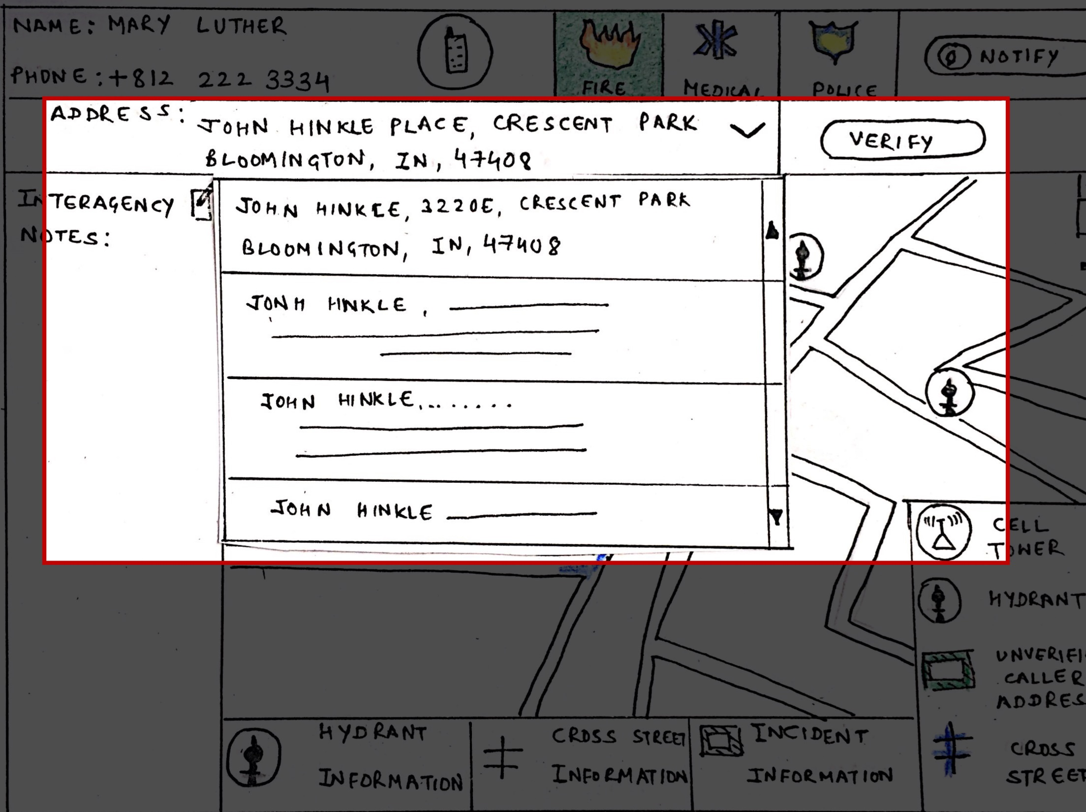

Slide 18
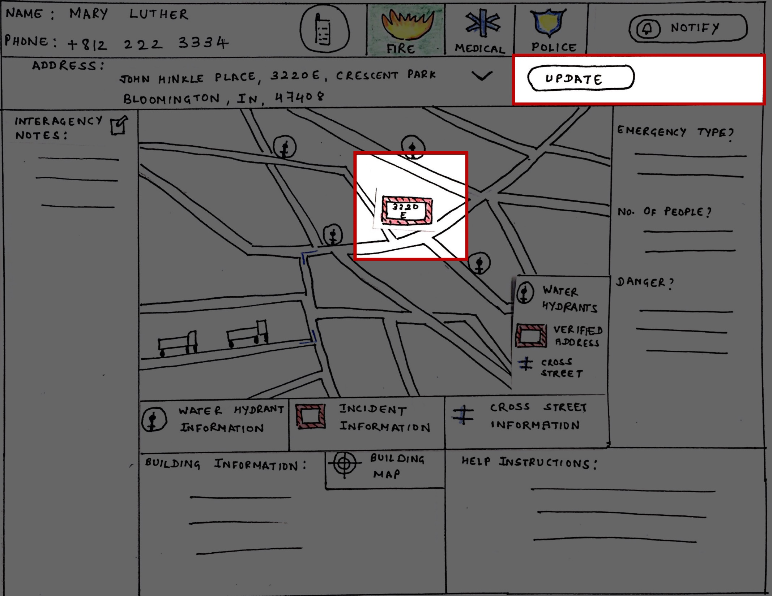

Slide 19
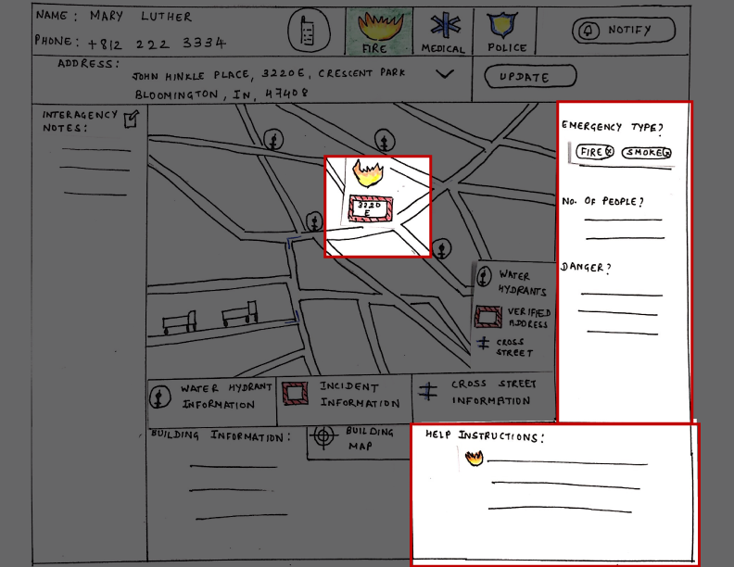

Slide 20
ACT

Slide 21
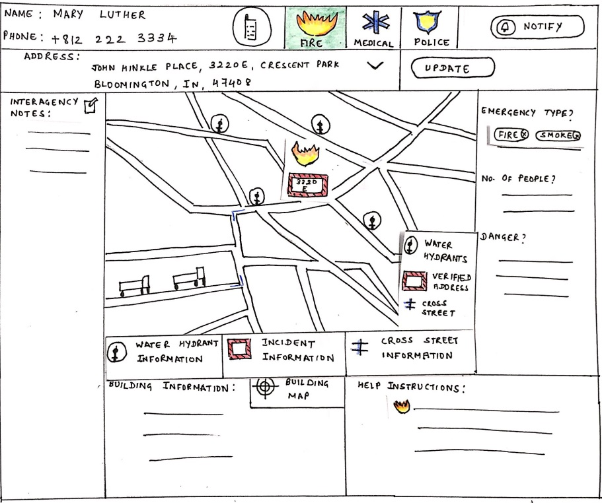
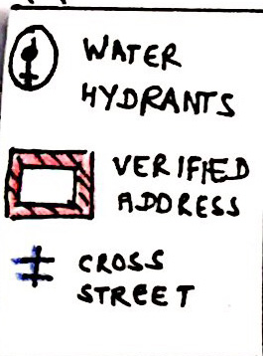
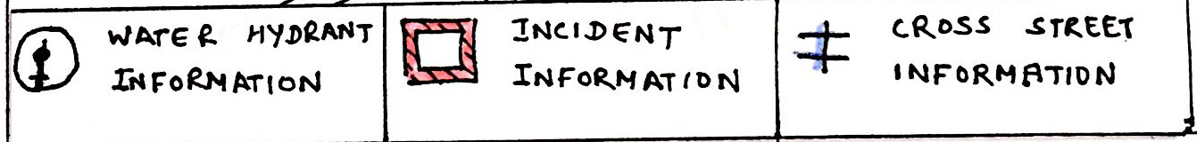
LEGEND
BUTTONS

Slide 22


Slide 23
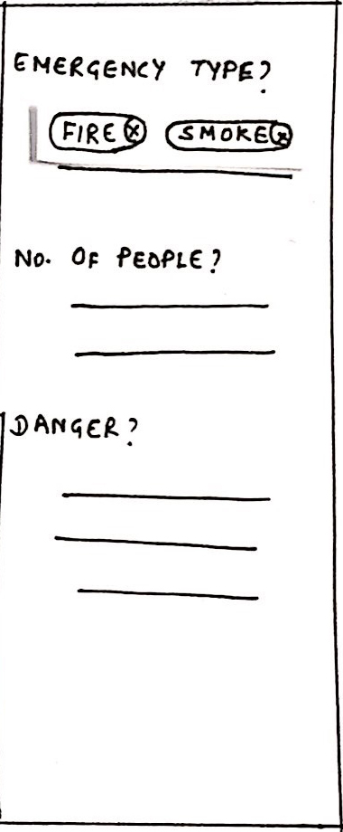

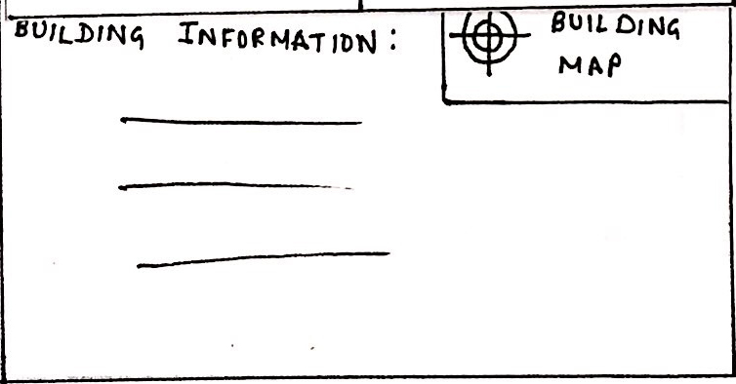
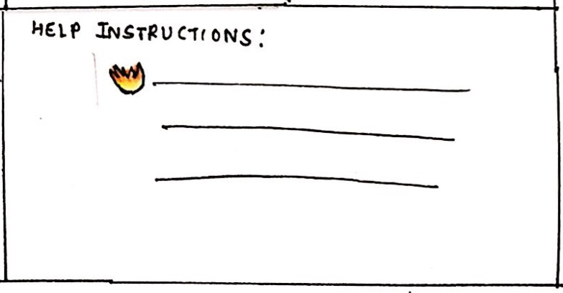
INFORMATION PANELS

Slide 24
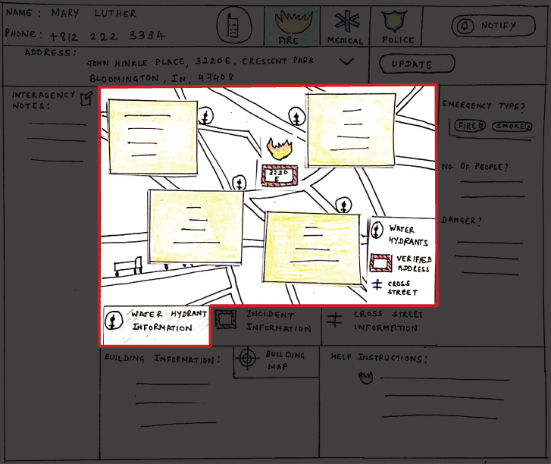

Slide 25

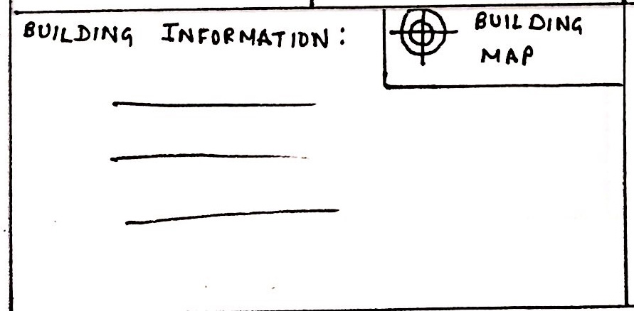
BUILDING INFO

Slide 26
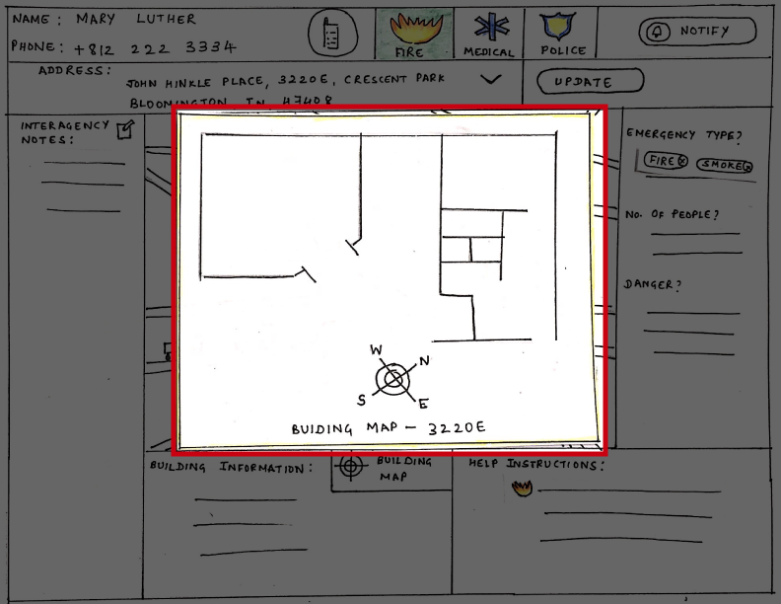

Slide 27
60

Slide 28
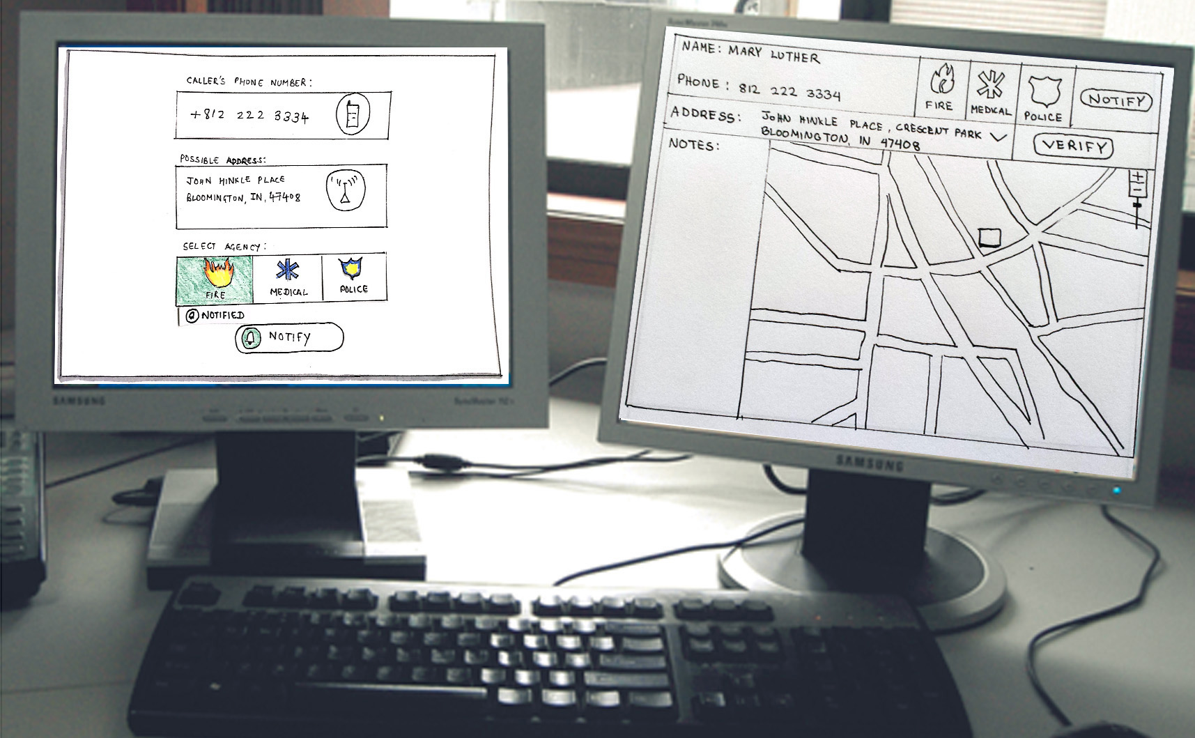

Slide 29
30

Slide 30
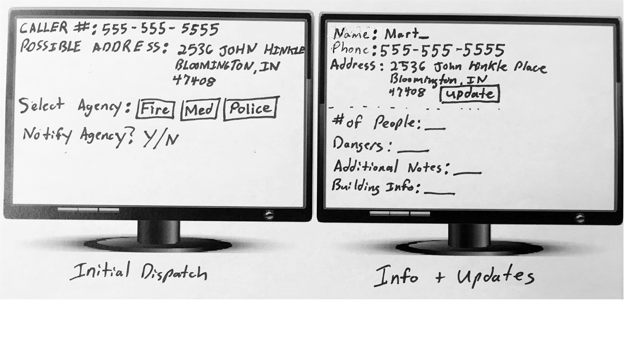

Slide 31
Q&A

